Slide 1
PGM 2002/03 Tirgul5
Clique/Junction Tree Inference

Slide 2
Outline
In class we saw how to construct junction tree via graph theoretic prinicipals
In the last tirgul we saw the algebric connection between elimination and message propagation
In this tirgul we will see how elimination in a general graph implies a triangulation and a junction tree and use this to define a practical algrithm for exact inference in general graphs

Slide 3
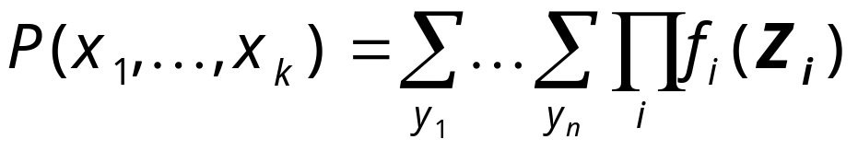
Undirected graph representation
At each stage of the procedure, we have an algebraic term that we need to evaluate
In general this term is of the form:
where Z_{i} are sets of variables
We now plot a graph where there is an undirected edge X--Y if X,Y are arguments of some factor
  that is, if X,Y are in some Z_{i}
Note: this is the Markov network that describes the probability on the variables we did not eliminate yet

Slide 4
Undirected Graph Representation
Consider the “Asia” example
The initial factors are
thus, the undirected graph is
In this case this graph is just the moralized graph
V
S
V
S
T
L
T
L
A
B
A
B
X
D
X
D

Slide 5
Elimination in Undirected Graphs
Generalizing, we see that we can eliminate a variable _{x} by
  1. For all Y,Z, s.t., Y--X, Z--X
    add an edge Y--Z
  2. Remove X and all adjacent edges to it
This procedure creates a clique that contains all the neighbors of X
After step 1 we have a clique that corresponds to the intermediate factor (before marginalization)
The cost of the step is exponential in the size of this clique

Slide 6
Undirected Graphs
The process of eliminating nodes from an undirected graph gives us a clue to the complexity of inference
To see this, we will examine the graph that contains all of the edges we added during the elimination

Slide 7
Example
V
S
T
L
Want to compute P(L)
Moralizing
A
B
X
D
V
S
T
L
A
B
X
D

Slide 8
Example
V
S
T
L
Want to compute P(L)
Moralizing
Eliminating v
  Multiply to get f’_{v}(v,t)
  Result f_{v}(t)
A
B
X
D
V
S
T
L
A
B
X
D

Slide 9
Example
V
S
T
L
Want to compute P(L)
Moralizing
Eliminating v
Eliminating x
  Multiply to get f’_{x}(a,x)
  Result f_{x}(a)
A
B
X
D
V
S
T
L
A
B
X
D

Slide 10
Example
V
S
T
L
Want to compute P(L)
Moralizing
Eliminating v
Eliminating x
Eliminating s
  Multiply to get f’_{s}(l,b,s)
  Result f_{s}(l,b)
A
B
X
D
V
S
T
L
A
B
X
D

Slide 11
Example
V
S
T
L
Want to compute P(D)
Moralizing
Eliminating v
Eliminating x
Eliminating s
Eliminating t
  Multiply to get f’_{t}(a,l,t)
  Result f_{t}(a,l)
A
B
X
D
V
S
T
L
A
B
X
D

Slide 12
Example
V
S
T
L
Want to compute P(D)
Moralizing
Eliminating v
Eliminating x
Eliminating s
Eliminating t
Eliminating l
  Multiply to get f’_{l}(a,b,l)
  Result f_{l}(a,b)
A
B
X
D
V
S
T
L
A
B
X
D

Slide 13
Example
V
S
T
L
Want to compute P(D)
Moralizing
Eliminating v
Eliminating x
Eliminating s
Eliminating t
Eliminating l
Eliminating a, b
  Multiply to get f’_{a}(a,b,d)
  Result f(d)
A
B
X
D
V
S
T
L
A
B
X
D

Slide 14
Expanded Graphs
V
S
The resulting graph is the induced
graph (for this particular ordering)
Main property:
  Every maximal clique in the induced graph
  corresponds to an intermediate factor in the computation
  Every factor stored during the process is a subset of some maximal clique in the graph
These facts are true for any variable elimination ordering on any network
T
L
A
B
X
D

Slide 15
Induced Width
The size of the largest clique in the induced graph is thus an indicator for the complexity of variable elimination
This quantity is called the induced width of a graph according to the specified ordering
Finding a good ordering for a graph is equivalent to finding the minimal induced width of the graph

Slide 16
Chordal Graphs
Recall:
elimination ordering ⇒ undirected chordal graph
Graph:
Maximal cliques are factors in elimination
Factors in elimination are cliques in the graph
Complexity is exponential in size of the largest clique in graph
V
S
V
S
T
L
T
L
A
B
A
B
X
D
X
D

Slide 17
Cluster Trees
Variable elimination ⇒ graph of clusters
Nodes in graph are annotated by
the variables in a factor
  Clusters: circles correspond to multiplication
  Separators: boxes correspond to marginalization
T,V
T
V
S
A,L,T
B,L,S
T
L
A,L
B,L
A
B
A,L,B
X,A
X
D
A,B
A
A,B,D

Slide 18
Properties of cluster trees
T,V
Cluster graph must be a tree
  Only one path between any
  two clusters
A separator is labeled by the
intersection of the labels of the
two neighboring clusters
Running intersection property:
  All separators on the path between
  two clusters contain their intersection
T
A,L,T
B,L,S
A,L
B,L
A,L,B
X,A
A,B
A
A,B,D

Slide 19
Cluster Trees & Chordal Graphs
Combining the two representations we get that:
  Every maximal clique in chordal is a cluster in tree
  Every separator in tree is a separator in the chordal graph
T,V
T
V
S
A,L,T
B,L,S
T
L
A,L
B,L
A
B
A,L,B
X,A
X
D
A,B
A
A,B,D

Slide 20
Cluster Trees & Chordal Graphs
Observation:
If a cluster is not a maximal clique, then it must be adjacent to one that is a superset of it
We might as well work with cluster tree where each cluster is a maximal clique
T,V
T
V
S
A,L,T
B,L,S
T
L
A,L
B,L
A
B
A,L,B
X,A
X
D
A,B
A
A,B,D

Slide 21
Cluster Trees & Chordal Graphs
Thm:
If G is a chordal graph, then it can be embedded in a tree of cliques such that:
  Every clique in G is a subset of at least one node in the tree
  The tree satisfies the running intersection property

Slide 22
Elimination in Chordal Graphs
S
V
T
L
A separator S divides the remaining
variables in the graph in to two groups
  Variables in each group appear on
  one “side” in the cluster tree
Examples:
  {A,B}: {L, S, T, V} & {D, X}
  {A,L}: {T, V} & {B,D,S,X}
  {B,L}: {S} & {A, D,T, V, X}
  {A}: {X} & {B,D,L, S, T, V}
  {T}; {V} & {A, B, D, K, S, X}
A
B
X
D
T,V
T
A,L,T
B,L,S
A,L
B,L
A,L,B
X,A
A,B
A
A,B,D

Slide 23
Elimination in Cluster Trees
Let X and Y be the partition induced by S
Observation:
Eliminating all variables in X results in a factor f_{X}(S)
Proof: Since S is a separator
only variables in S are adjacent
to variables in X
Note:The same factor would
result, regardless of
elimination ordering
x
f_{X}(S)
S
A
B
f_{Y}(S)
y

Slide 24
Recursive Elimination in Cluster Trees
How do we compute f_{X}(S) ?
By recursive decomposition along
cluster tree
  Let X₁ and X₂ be the disjoint
  partitioning of X - C implied by the
  separators S₁ and S₂
  Eliminate X₁ to get f_{X1}(S₁)
  Eliminate X₂ to get f_{X2}(S₂)
  Eliminate variables in C - S to
  get f_{X}(S)
x₁
x₂
S1
S2
C
S
y

Slide 25
Elimination in Cluster Trees
(or Belief Propagation revisited)
Assume we have a cluster tree
Separators: S₁,…,S_{k}
Each S_{i} determines two sets of variables X_{i} and Y_{i}, s.t.
  S_{i} ∪ X_{i} ∪ Y_{i} = {X₁,…,X_{n}}
  All paths from clusters containing variables in X_{i} to clusters containing variables in Y_{i} pass through S_{i}
We want to compute f_{Xi}(S_{i}) and f_{Yi}(S_{i}) for all i

Slide 26
Elimination in Cluster Trees
Idea:
Each of these factors can be decomposed as an expression involving some of the others
Use dynamic programming to avoid recomputation of factors

Slide 27
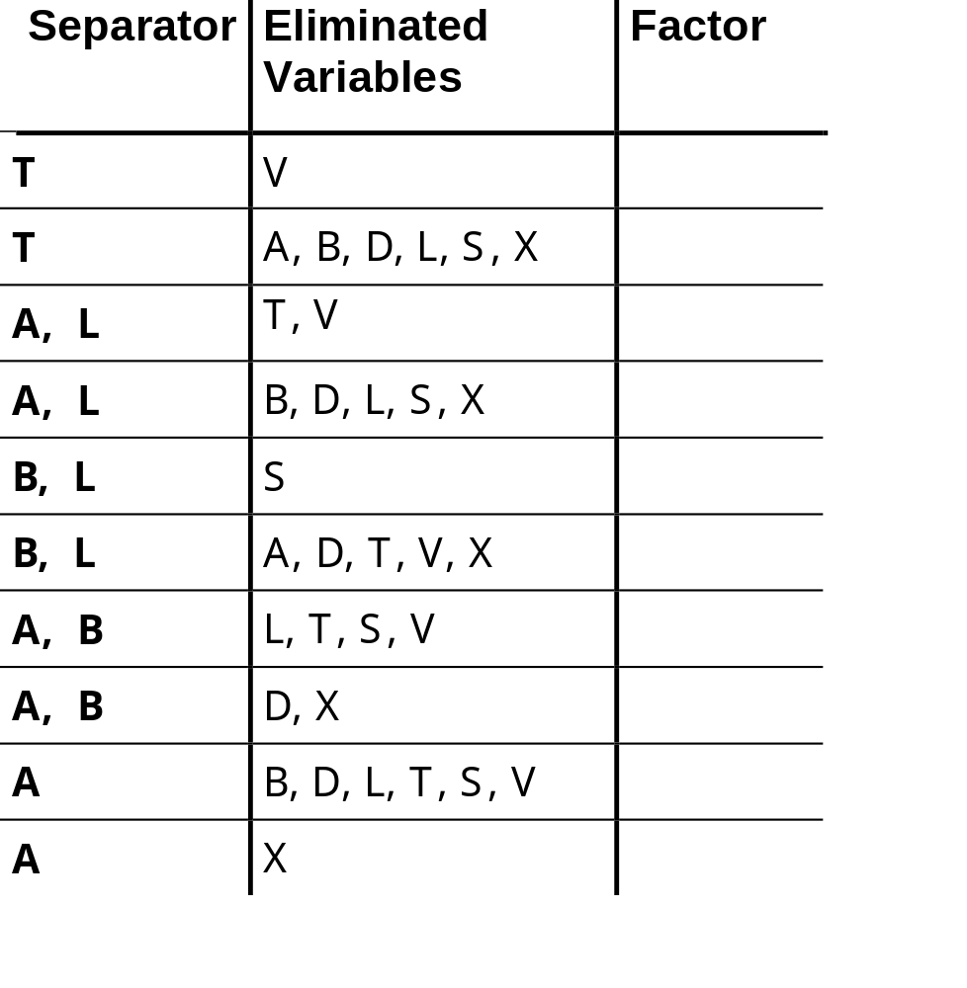
Example
T,V
T
A,L,T
B,L,S
A,L
B,L
A,L,B
X,A
A,B
A
A,B,D

Slide 28
Dynamic Programming
We now have the tools to solve the multi-query problem
Step 1: Inward propagation
  Pick a cluster C
  Compute all factors eliminating from
  fringes of the tree toward C
  This computes all “inward” factors
  associated with separators
C

Slide 29
Dynamic Programming
We now have the tools to solve the multi-query problem
Step 1: Inward propagation
Step 2: Outward propagation
  Compute all factors on separators
  going outward from C to fringes
C

Slide 30
Dynamic Programming
We now have the tools to solve the multi-query problem
Step 1: Inward propagation
Step 2: Outward propagation
Step 3: Computing beliefs on clusters
To get belief on a cluster C’ multiply:
  CPDs that involve only variables in C’
  Factors on separators adjacent to
  C’ using the proper direction
This simulates the result of elimination
of all variables except these in C’
using pre-computed factors
C
C’’

Slide 31
Complexity
Time complexity:
Each traversal of the tree costs the same as standard variable elimination
Total computation cost is twice of standard variable elimination
Space complexity:
Need to store partial results
Requires two factors for each separator
Space requirements can be up to 2n more expensive than variable elimination

Slide 32
The “Asia” network with evidence
Visit to
Asia
Smoking
Tuberculosis
Lung Cancer
Abnormality
in Chest
Bronchitis
X-Ray
Dyspnea
We want to compute P(L|D=t,V=t,S=f)

Slide 33
Initial factors with evidence
We want to compute P(L|D=t,V=t,S=f)
P(T|V):
( ( Tuberculosis false ) ( VisitToAsia true ) ) 0.95
( ( Tuberculosis true ) ( VisitToAsia true ) ) 0.05
P(B|S):
( ( Bronchitis false ) ( Smoking false ) ) 0.7
( ( Bronchitis true ) ( Smoking false ) ) 0.3
P(L|S):
( ( LungCancer false ) ( Smoking false ) ) 0.99
( ( LungCancer true ) ( Smoking false ) ) 0.01
P(D|B,A):
( ( Dyspnea true ) ( Bronchitis false ) ( AbnormalityInChest false ) ) 0.1
( ( Dyspnea true ) ( Bronchitis true ) ( AbnormalityInChest false ) ) 0.8
( ( Dyspnea true ) ( Bronchitis false ) ( AbnormalityInChest true ) ) 0.7
( ( Dyspnea true ) ( Bronchitis true ) ( AbnormalityInChest true ) ) 0.9

Slide 34
Initial factors with evidence (cont.)
P(A|L,T):
( ( Tuberculosis false ) ( LungCancer false ) ( AbnormalityInChest false ) ) 1 ( ( Tuberculosis true ) ( LungCancer false ) ( AbnormalityInChest false ) ) 0
( ( Tuberculosis false ) ( LungCancer true ) ( AbnormalityInChest false ) ) 0
( ( Tuberculosis true ) ( LungCancer true ) ( AbnormalityInChest false ) ) 0
( ( Tuberculosis false ) ( LungCancer false ) ( AbnormalityInChest true ) ) 0
( ( Tuberculosis true ) ( LungCancer false ) ( AbnormalityInChest true ) ) 1
( ( Tuberculosis false ) ( LungCancer true ) ( AbnormalityInChest true ) ) 1
( ( Tuberculosis true ) ( LungCancer true ) ( AbnormalityInChest true ) ) 1
P(X|A):
( ( X-Ray false ) ( AbnormalityInChest false ) ) 0.95
( ( X-Ray true ) ( AbnormalityInChest false ) ) 0.05
( ( X-Ray false ) ( AbnormalityInChest true ) ) 0.02
( ( X-Ray true ) ( AbnormalityInChest true ) ) 0.98

Slide 35
Step 1: Initial Clique values
T,V
C_{T}=P(T|V)
T
C_{B,L}=P(L|S)P(B|S)
T,L,A
B,L,S
C_{T,L,A}=P(A|L,T)
L,A
B,L
C_{X,A}=P(X|A)
B,L,A
X,A
C_{B,L,A}=1
B,A
A
“dummy” separators:
this is the intersection between nodes in the junction tree and helps in defining the inference messages (see below)
D,B,A
C_{B,A}=1

Slide 36
Step 2: Update from leaves
T,V
C_{T}
T
S↓_{T}=∑C_{T}
T,L,A
B,L,S
C_{T,L,A}
C_{B,L}
L,A
B,L
S ↓ _{B,L}=ΣC_{B,L}
B,L,A
X,A
C_{B,L,A}
C_{X,A}
B,A
A
D,B,A
S ↓ _{A}=ΣC_{X,A}
C_{B,A}

Slide 37
Step 3: Update (cont.)
T,V
C_{T}
T
S↓_{T}
T,L,A
B,L,S
C_{T,L,A}
C_{B,L}
L,A
B,L
S↓_{L,A}=∑(C_{T,L,A}x S↓_{T})
S↓_{B,L}
B,L,A
X,A
C_{B,L,A}
C_{X,A}
S↑_{B,A}=∑(C_{B,A}x S↓_{A})
B,A
A
S↓_{A}
D,B,A
C_{B,A}

Slide 38
Step 4: Update (cont.)
T,V
C_{T}
T
S↓_{T}
T,L,A
B,L,S
C_{T,L,A}
C_{B,L}
S↓_{B,L}
S↑_{L,A}=∑(C_{B,L,A}x S↓_{B,L}XS↑_{B,A})
L,A
B,L
S↓_{L,A}
S↑_{B,L}=∑(C_{B,L,A}x S↓_{L,A}XS↑_{B,A})
B,L,A
C_{B,L,A}
X,A
C_{X,A}
B,A
S↑_{B,A}
A
S↓_{A}
S↓_{B,A}=∑(C_{B,L,A}x S↓_{L,A}xS↓_{B,L})
D,B,A
C_{B,A}

Slide 39
Step 5: Update (cont.)
T,V
C_{T}
S↓_{T}
T
S↑_{T}=∑(C_{T,L,A}x S ↑ _{L,A})
T,L,A
B,L,S
C_{T,L,A}
C_{B,L}
S↓_{B,L}
S↑_{L,A}
L,A
S↓_{L,A}
B,L
S↑_{B,L}
B,L,A
C_{B,L,A}
X,A
S↓_{A}
C_{X,A}
S↓_{B,A}
B,A
S↑_{B,A}
A
D,B,A
S↑_{A}=∑(C_{B,A}x S↓_{B,A})
C_{B,A}

Slide 40
Step 6: Compute Query
P(L|D=t,V=t,S=f) = ∑(C_{B,L}x S↑_{B,L}) = ∑(C_{B,L,A}x S↓_{L,A} x S↓_{B,L} x S ↑ _{B,A}) = …
and normalize
T,V
C_{T}
S↓_{T}
T
S↑_{T}
T,L,A
B,L,S
C_{T,L,A}
C_{B,L}
S↓_{B,L}
S↑_{L,A}
L,A
S↓_{L,A}
B,L
S↑_{B,L}
B,L,A
C_{B,L,A}
X,A
S↓_{A}
C_{X,A}
S↓_{B,A}
B,A
S↑_{B,A}
A
D,B,A
S↑_{A}
C_{B,A}

Slide 41
How to avoid small numbers
P(L|D=t,V=t,S=f) = ∑(C_{B,L}x S↑_{B,L}) = ∑(C_{B,L,A}x S↓_{L,A} x S↓_{B,L} x S ↑ _{B,A}) = …
and normalize (with N₁xN₂xN₃xN₄xN₅xN_{BLA})
T,V
C_{T}
S↓_{T}
T
S↑_{T}
Normalize by N₁
Normalize by N₄
T,L,A
B,L,S
C_{T,L,A}
C_{B,L}
S↓_{B,L}
S↓_{L,A}
L,A
S↑_{L,A}
B,L
S↑_{B,L}
Normalize by N₂
B,L,A
C_{B,L,A}
X,A
Normalize by N₅
C_{X,A}
S↓_{B,A}
B,A
S↑_{B,A}
S↑_{A}
A
S↓_{A}
D,B,A
C_{B,A}
Normalize by N₃

Slide 42
A Theorem about elimination order
Triangulated graph: a graph that has no cycle with length > 3 without a chord.
Simplicial node: a node that can be eliminated without the need for addition of an extra edge, i.e. all its neighbouring nodes are connected (they form a complete subgraph).
Eliminatable graph: a graph which has an elimination order without the need to add edges - all the nodes are simplicial in that order.
Thm: Every triangulated graph is eliminatable.

Slide 43
Lemma: An uncomplete triangulated graph G with a node set N (at least 3) has a complete subset S which separates the graph - every path between the two parts of N/S goes through S.
Proof: Let S be a minimal set of nodes such that any path between non-adjacent nodes A and B contains a node from S. Assume that C,D in S are not neighbors. Since S is minimal, there is a path from A to B in G passing only through C in S (and same for D). Then there is a path from C to D in G_{A} and in G_{B}. This path is a cycle that a chord C--D must break.
G_{A}
G_{B}
A
S
B

Slide 44
Claim: Let G be a triangulated graph . We always have two simplicial nodes that can be chosen nonadjacent (if the graph is not complete).
Proof: The claim is trivial for a complete graph and a graph with 2 nodes. Let G have n nodes. If G_{A} is complete choose any simplicial node outside S. If not, choose one of the two outside S (they cannot be both in S or they will be adjacent). Same can be done for G_{B} and nodes are non-adjacent (separated by S).
Wrapping up: Any graph with 2 nodes is triangulated and eliminatable. The claim gives us more than the single simplicial node we need.
* Full proof can be found at Jensen, Appendix A.

